Slide 1
Chapter 2 statistical learning

Slide 2
Outline
2.1 What Is Statistical Learning? 2.1.1 Why Estimate f ? 2.1.2 How Do We Estimate f ? 2.1.3 The Trade-Off Between Prediction Accuracy and Model Interpretability 2.1.4 Supervised Versus Unsupervised Learning 2.1.5 Regression Versus Classification Problems .
2.2 Assessing Model Accuracy 2.2.1 Measuring the Quality of Fit 2.2.2 The Bias-Variance Trade-Off 2.2.3 The Classification Setting

Slide 3
2.1 What Is Statistical Learning?
Suppose that we are statistical consultants hired by a client to provide advice on how to improve sales of a particular product.
The Advertising data set consists of the sales of that product in 200 different markets, along with advertising budgets for the product in each of those markets for three different media: TV, radio, and newspaper.
our goal is to develop an accurate model that can be used to predict sales on the basis of the three media budgets.

Slide 4
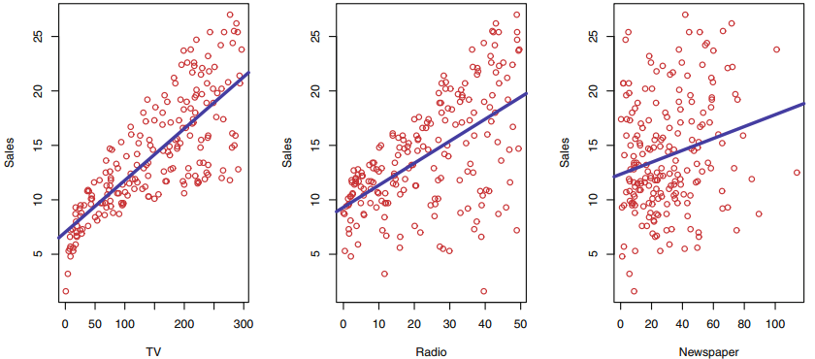

Slide 5

More generally, suppose that we observe a quantitative response Y and p different predictors, X₁, X₂, . . . , X_{p}. We assume that there is some relationship between Y and X = (X₁, X₂, . . . , X_{p}), which can be written in the very general form

Slide 6

2.1.1 Why Estimate f?
Prediction
In many situations, a set of inputs X are readily available, but the output Y cannot be easily obtained. In this setting, since the error term averages to zero, we can predict Y using

Slide 7
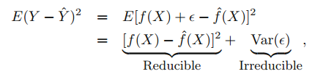
Consider a given estimate f ˆ and a set of predictors X, which yields the prediction Y ˆ = f ˆ(X). Assume for a moment that both f ˆ and X are fixed. Then, it is easy to show that

Slide 8
Inference Which predictors are associated with the response?
What is the relationship between the response and each predictor? Can the relationship between Y and each predictor be adequately summarized using a linear equation, or is the relationship more complicated?

Slide 9
2.1.2 How Do We Estimate f?
Parametric Methods Parametric methods involve a two-step model-based approach. 1. First, we make an assumption about the functional form, or shape, of f.
2. After a model has been selected, we need a procedure that uses the training data to fit or train the model.

Slide 10
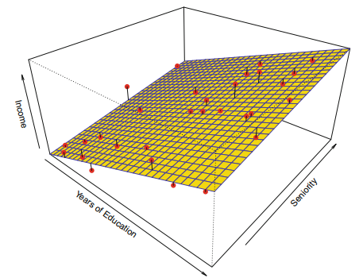

Slide 11
Non-parametric Methods Non-parametric methods do not make explicit assumptions about the functional form of f. Instead they seek an estimate of f that gets as close to the data points as possible without being too rough or wiggly. Such approaches can have a major advantage over parametric approaches: by avoiding the assumption of a particular functional form for f, they have the potential to accurately fit a wider range of possible shapes for f.

Slide 12
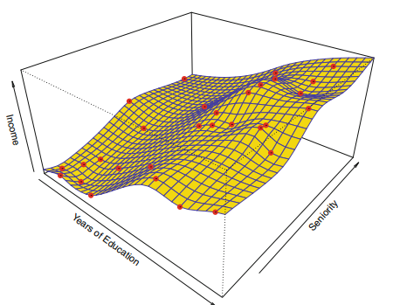

Slide 13
2.1.3 The Trade-Off Between Prediction Accuracy and Model Interpretability
We have established that when inference is the goal, there are clear advantages to using simple and relatively inflexible statistical learning methods.
In some settings, however, we are only interested in prediction, and the interpretability of the predictive model is simply not of interest. For instance, if we seek to develop an algorithm to predict the price of a stock, our sole requirement for the algorithm is that it predict accurately—interpretability is not a concern. In this setting, we might expect that it will be best to use the most flexible model available.

Slide 14
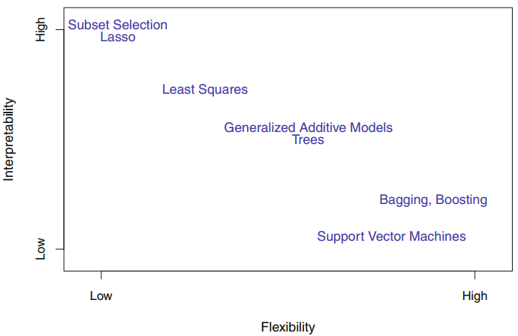

Slide 15
2.1.4 Supervised Versus Unsupervised Learning
Most statistical learning problems fall into one of two categories: supervised or unsupervised.
Supervised：We wish to fit a model that relates the response to the predictors, with the aim of accurately predicting the response for future observations (prediction) or better understanding the relationship between the response and the predictors (inference).
Unsupervised： It is not possible to fit a linear regression model, since there is no response variable to predict. In this setting, we are in some sense working blind; the situation is referred to as unsupervised because we lack a response variable that can supervise our analysis.

Slide 16
Semi-supervised learning problem：
For m of the observations, where m < n, we have both predictor measurements and a response measurement. For the remaining n − m observations, we have predictor measurements but no response measurement.

Slide 17
2.1.5 Regression Versus Classification Problems
We tend to refer to problems with a quantitative response as regression problems, while those involving a qualitative response are often referred to as classification problems.

Slide 18
2.2 Assessing Model Accuracy
There is no free lunch in statistics: no one method dominates all others over all possible data sets. On a particular data set, one specific method may work best, but some other method may work better on a similar but different data set.
In this section, we discuss some of the most important concepts that arise in selecting a statistical learning procedure for a specific data set.

Slide 19


2.2.1 Measuring the Quality of Fit
In the regression setting, the most commonly-used measure is the mean squared error (MSE), given by
The MSE is computed using the training data that was used to fit the model, and so should more accurately be referred to as the training MSE. But in general, we do not really care how well the method works training on the training data. Rather, we are interested in the accuracy of the predictions that we obtain when we apply our method to previously unseen test data.

Slide 20
In that case, one might imagine simply selecting a statistical learning method that minimizes the training MSE. This seems like it might be a sensible approach, since the training MSE and the test MSE appear to be closely related. Unfortunately, there is a fundamental problem with this strategy: there is no guarantee that the method with the lowest training MSE will also have the lowest test MSE.

Slide 21
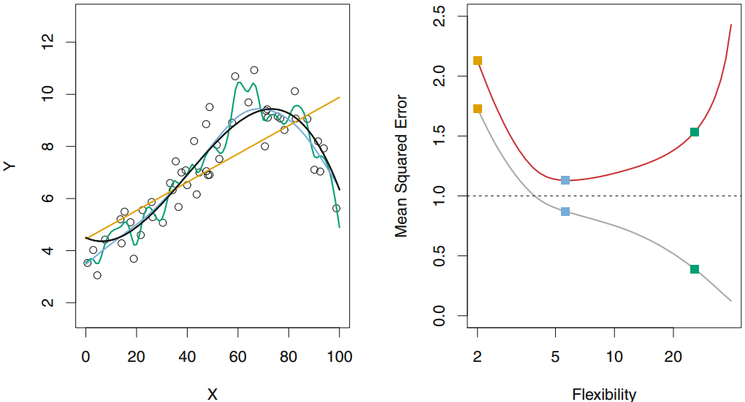

Slide 22

2.2.2 The Bias-Variance Trade-Off
Variance refers to the amount by which f ˆ would change if we estimated it using a different training data set. Since the training data are used to fit the statistical learning method, different training data sets will result in a different f ˆ. But ideally the estimate for f should not vary too much between training sets.
Bias refers to the error that is introduced by approximating a real-life problem, which may be extremely complicated, by a much simpler model.

Slide 23
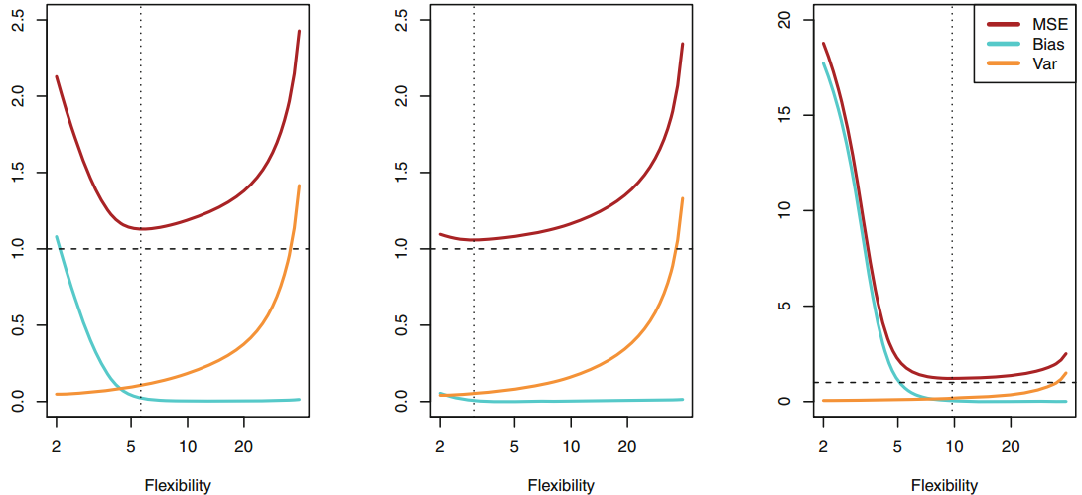

Slide 24


2.2.3 The Classification Setting
The most common approach for quantifying the accuracy of our estimate f ˆ is the training error rate, the proportion of mistakes that are made if we apply our estimate f ˆ to the training observations:

Slide 25

The Bayes Classifier
It is possible to show that the test error rate given in (2.9) is minimized, on average, by a very simple classifier that assigns each observation to the most likely class, given its predictor values. In other words, we should simply assign a test observation with predictor vector x₀ to the class j for which

Slide 26

K-Nearest Neighbors
In theory we would always like to predict qualitative responses using the Bayes classifier. But for real data, we do not know the conditional distribution of Y given X, and so computing the Bayes classifier is impossible.
K-nearest neighbors (KNN) classifier

Slide 27
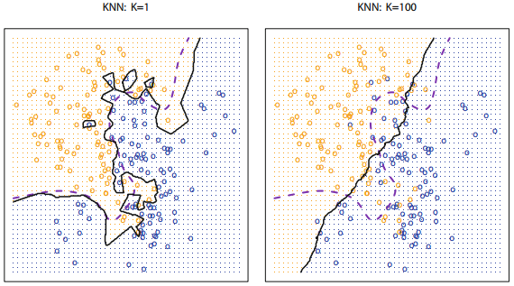

Slide 28
Introduction to R

Slide 29
Basic Commands vector
x <- c(1 ,3 ,2 ,5) x = c(1 ,6 ,2) y = c(1 ,4 ,3) length (x) length (y) x+y ls() rm(x,y) ls() rm( list=ls ())

Slide 30
Basic Commands matrix
? matrix
x= matrix ( data=c(1 ,2 ,3 ,4) , nrow =2, ncol =2)
x= matrix (c(1 ,2 ,3 ,4) ,2,2) matrix (c(1 ,2 ,3 ,4) ,2,2, byrow =TRUE) sqrt(x)
x^2

Slide 31
Basic Commands random number
x= rnorm (50) y=x+ rnorm (50, mean =50, sd =.1) cor (x,y) set . seed (1303) rnorm (50) set . seed (3) y= rnorm (100) mean(y) var (y) sqrt(var (y)) sd(y)

Slide 32
Graphics
x= rnorm (100) y= rnorm (100) plot(x,y) plot(x,y, xlab =" this is the x- axis", ylab =" this is the y-axis ", main =" Plot of X vs Y") pdf (" Figure .pdf ") plot(x,y,col =" green ") dev . off ()

Slide 33
Indexing Data
A= matrix (1:16 ,4 ,4) A[2 ,3] A[c(1 ,3) ,c(2 ,4) ] A [1:3 ,2:4] A [1:2 ,] A [ ,1:2] A[1,] A[-c(1 ,3) ,] A[-c(1 ,3) ,-c(1 ,3 ,4) ] dim (A)

Slide 34
Loading Data
library(ISLR)
attach(Auto)
Auto=read .table (" Auto .data ") fix (Auto) Auto=read .table (" Auto .data", header =T, na.strings ="?") fix (Auto) Auto=read .csv (" Auto.csv ", header =T, na.strings ="?") fix (Auto) dim (Auto) names (Auto)
Auto=na.omit (Auto) dim ( Auto)

Slide 35
Additional Graphical and Numerical Summaries
plot( Auto$cylinders , Auto$mpg )
attach (Auto)
plot(cylinders , mpg )
cylinders =as.factor ( cylinders )
plot(cylinders, mpg )
plot(cylinders, mpg , col ="red")
plot(cylinders, mpg , col ="red", varwidth =T)
plot(cylinders, mpg , col ="red", varwidth =T, horizontal =T)
plot(cylinders, mpg , col ="red", varwidth =T, xlab =" cylinders ", ylab =" MPG ")

Slide 36
hist(mpg )
hist(mpg ,col =2)
hist(mpg ,col =2, breaks =15)
pairs ( Auto)
pairs (~ mpg + displacement + horsepower + weight + acceleration , Auto)
summary (Auto )

